Slide 1
User Behavior and Trend Analysis

Slide 2
Charlie lee placed the highest number of orders with 135, followed by Alice Johnson with 108, and Bob Smith with 72. These three users ordered 72.85% of the Total orders(315 out of 431).
Charlie lee, Alice johnson and Bob smith also have highest favourite meal with 9, Other users with fewer orders and tend to have only one favourite meal recorded.

Slide 3
The longest sessions are S003 and S009 with 120 minutes indicates high user engagement.
The total session duration is 1115 minutes with an average of 69.7 minutes.

Slide 4
Dinner is the most popular meal type with 18 orders, followed by Lunch with 11 orders, and Breakfast with only 9 orders.
Chicago and Los Angeles are top performing cities, each with 9 orders

Slide 5
Grilled Chicken is the most ordered dish with 106 orders(25%), followed by spaghetti with 94 orders(23%) and pancakes with 81 orders(19%).
Oat meal is the least ordered dish with only 24 orders(6%).

Slide 6
Grilled chicken contributes the most revenue, totaling $102.5
Spaghetti follows closely with $101.5 and Caesar salad with $75.
Oat meal generates the least revenue at $31.
The revenue data aligns with the popularity of dishes, with grilled chicken and spaghetti leading in both orders and revenue.

Slide 7
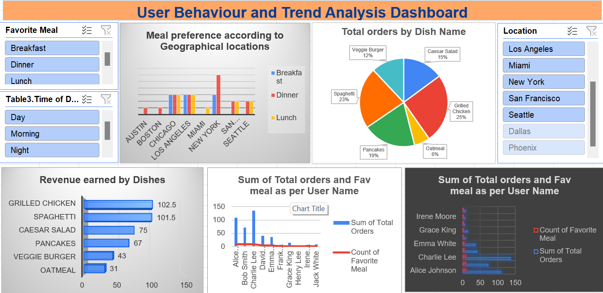

Slide 8
INSIGHTS
Charlie Lee, Alice Johnson, and Bob Smith dominate user engagement, accounting for 72.85% of total orders. Their preference towards their favorite meals (9 each) highlights their loyalty to specific menu items.
The longest sessions of S003 and S009, each with 120 minutes suggest highly engaged users. The total session duration of 1115 minutes with an average of 69.7 minutes indicates good user interaction.
Dinner is the most popular meal type with 18 orders, 47%, followed by Lunch with 11 orders, 29% and Breakfast with 9 orders, 24%.

Slide 9
Chicago and Los Angeles are the highest-performing cities, with 9 orders each, showcasing strong demand in these areas.
Grilled Chicken, Spaghetti, and Pancakes are the most popular dishes, accounting for a combined 67% of total orders.
Oatmeal is the least ordered dish with 6% of total orders and contributes the least revenue with $31.
Revenue aligns with dish popularity. Grilled Chicken and Spaghetti are leaders in both orders and revenue.
Oatmeal's low orders and revenue highlight it as an area for potential improvement.

Slide 10
RECOMMENDATIONS
Promote Grilled Chicken and Spaghetti as signature dishes through targeted marketing campaigns, upsells, and combo meals to boost revenue.
Provide offers or reward to loyal customers like Charlie Lee, Alice Johnson, and Bob Smith to maintain their high engagement.
Make changes in Oatmeal by enhancing its appeal like new flavors, healthier options or replacing it with a more profitable dish.
Dinner is the most popular meal type, consider introducing more variety or promoting dinner-specific combos.

Slide 11
Focus marketing efforts on top-performing cities like Chicago and Los Angeles to maximize returns. Expand operations in cities with untapped potential based on meal preferences.
Analyze user behavior in long sessions S003 and S009 to replicate successful engagement strategies so that we can adapt to other sessions also.

